Slide 1




Intelligent HRM Solution
Step Towards:
(HR Automation)
Project Status Report: Dated 20 JAN 2025

Slide 2
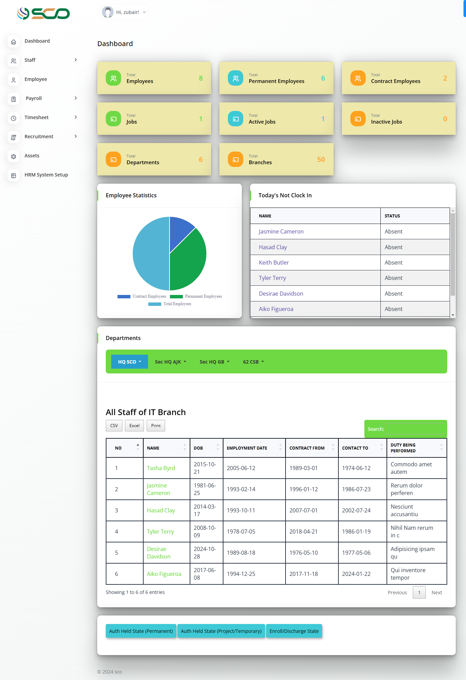
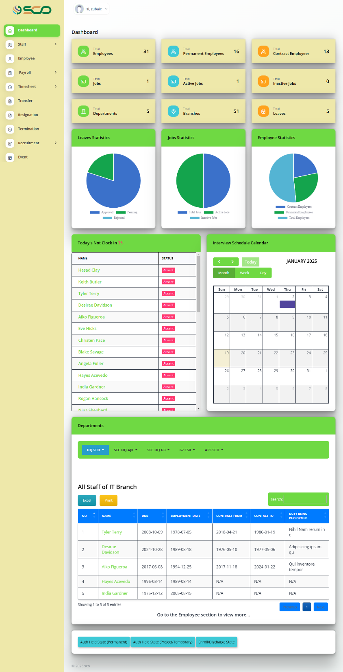
PROJECT STATUS - ABSTRACT
Modules Status
Sr. # | Modules | Status
1 | Dashboard | Partially Delivered (Incomplete Requirements)
2 | Staff Management | Delivered
3 | Employee Management | Partially Delivered (Pdf Column Export Pending; Delayed Due to New Requirements)
4 | Payroll Management | Delivered
5 | Leave Management | Delivered
6 | Attendance Management | Partially Delivered (New Feature and Incomplete Requirements)
7 | Transfers Management | Delivered
8 | Resignation Management | Delivered
9 | Termination Management | Delivered
10 | Recruitment Management | Delivered
11 | Assets Management | Delivered
12 | HRM System Setup | Delivered
13 | All Modules | Custom Column Selection: New and Incomplete Requirements

Slide 3
Key Features :: Delivery Status
Dashboard
Sr#. | Module | Feature | Status | Remarks
1 | Dashboard | Widgets Section | Complete | This module is completed and tested by the developer and awaiting SCO feedback.
2 |  | Pie Chart Section | Complete | This module is completed and tested by the developer and awaiting SCO feedback.
3 |  | Attendance Section | Complete | This module is completed and tested by the developer and awaiting SCO feedback.
4 |  | Interview Schedule Calendar Section | Complete | This module is completed and tested by the developer and awaiting SCO feedback.
5 |  | A Comprehensive Table for Displaying Some Filtered Employees | Complete | This module is completed and tested by the developer and awaiting SCO feedback.
6 |  | Export Data of Comprehensive Table Data | Complete | This module is completed and tested by the developer and awaiting SCO feedback.
7 |  | Directly Printing Data of Comprehensive Table Data | Complete | This module is completed and tested by the developer and awaiting SCO feedback.
8 |  | A Comprehensive Table for Displaying Some Stats of SCO | Pending | This module is incomplete because of incomplete requirements.

Slide 4
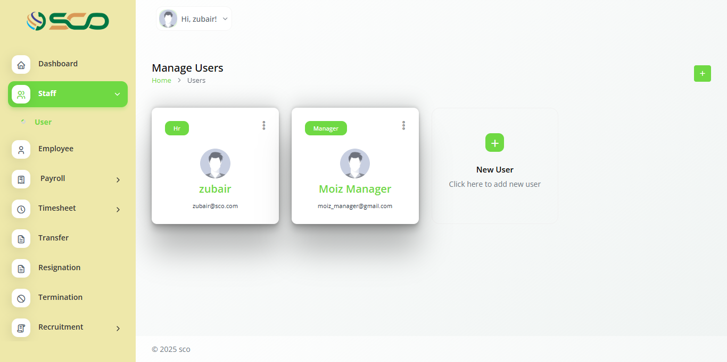
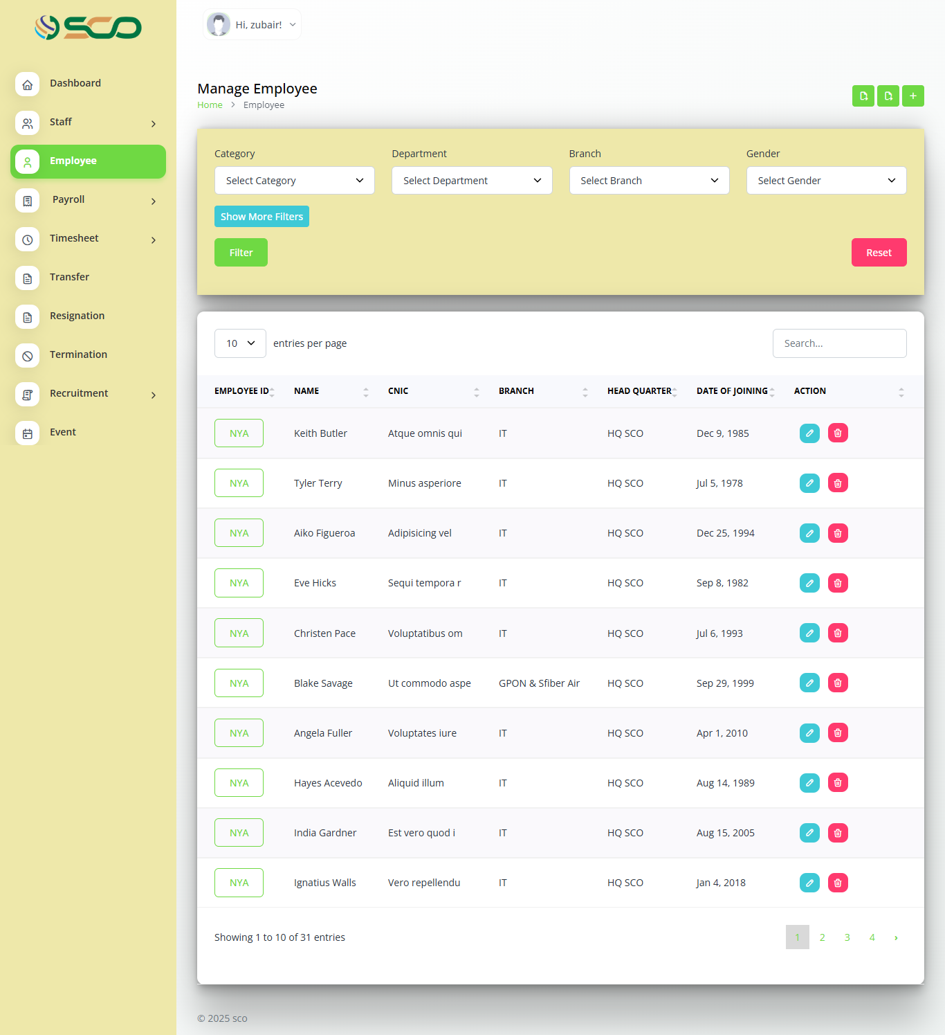
Key Features :: Delivery Status
Staff and Employee Management
Sr#. | Module | Feature | Status | Remarks
9 | Staff Management | Creation of Admin and Managers | Complete | This module is completed and tested by the developer and awaiting SCO feedback.
10 |  | Deletion of Admin and Managers | Complete | This module is completed and tested by the developer and awaiting SCO feedback.
11 |  | Password Reset of Admin and Managers | Complete | This module is completed and tested by the developer and awaiting SCO feedback.
12 | Employee Management | Employees List View | Complete | This module is completed and tested by the developer and awaiting SCO feedback
13 |  | Employees Filters | Complete | This module is completed and tested by the developer and awaiting SCO feedback
14 |  | Employees List Export Data | Complete | This module is completed and tested by the developer and awaiting SCO feedback
15 |  | Creation of Employee | Complete | This module is completed and tested by the developer and awaiting SCO feedback
16 |  | Deletion of Employee | Complete | This module is completed and tested by the developer and awaiting SCO feedback
17 |  | Detailed Profile Page | Complete | This module is completed and tested by the developer and awaiting SCO feedback
18 |  | Employees Profile Export | Complete | This module is completed and tested by the developer and awaiting SCO feedback
19 |  | Export Data with Selection of up to 85 Columns | In-Progress | This module is under development.

Slide 5
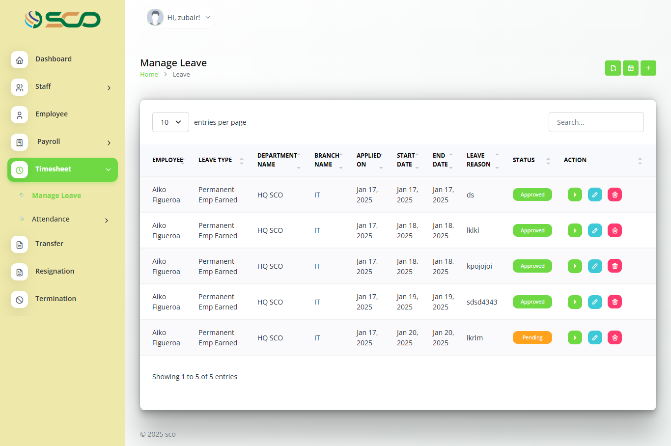
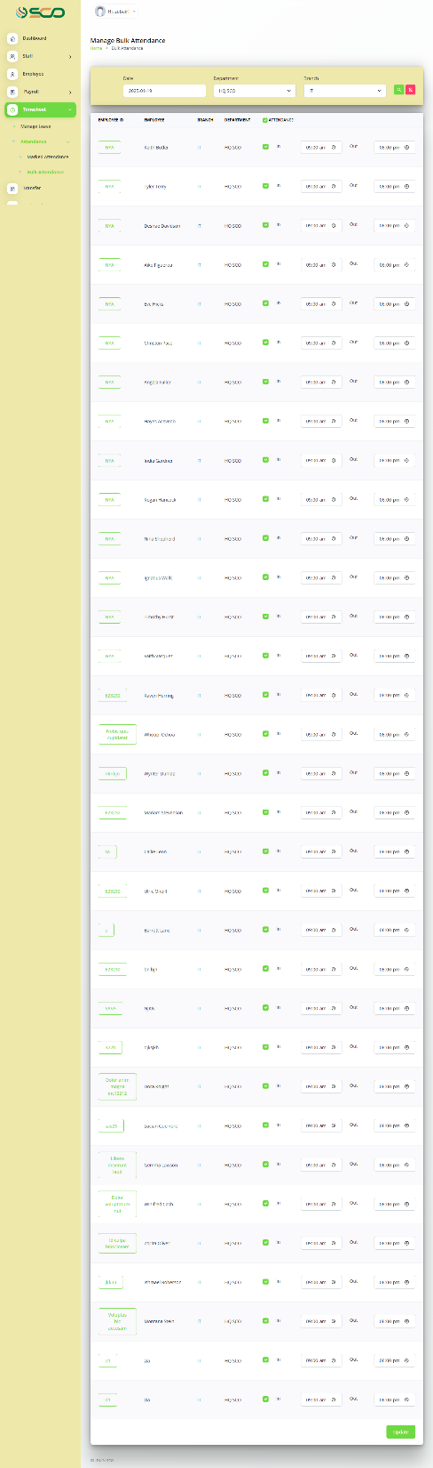
Key Features :: Delivery Status
Leave & Attendance Management
Sr#. | Module | Feature | Status | Remarks
25 | Leave Management | Leave List View | Complete | This module is completed and tested by the developer and awaiting SCO feedback
26 |  | Leave Filters View | Complete | This module is completed and tested by the developer and awaiting SCO feedback
27 |  | Leave Creation | Complete | This module is completed and tested by the developer and awaiting SCO feedback
28 |  | Deletion Creation | Complete | This module is completed and tested by the developer and awaiting SCO feedback
29 |  | Leave Applications Status Change | Complete | This module is completed and tested by the developer and awaiting SCO feedback
30 |  | Leave Calendar | Complete | This module is completed and tested by the developer and awaiting SCO feedback
31 |  | Leave Export Data | Complete | This module is completed and tested by the developer and awaiting SCO feedback
32 | Attendance Management | Bulk Attendance Creation | Complete | This module is completed and tested by the developer and awaiting SCO feedback
33 |  | Bulk Attendance Filters | Complete | This module is completed and tested by the developer and awaiting SCO feedback
34 |  | Marked Attendance Filters | Complete | This module is completed and tested by the developer and awaiting SCO feedback
35 |  | Marked Attendance List View | Complete | This module is completed and tested by the developer and awaiting SCO feedback
36 |  | Marked Attendance Actions | Complete | This module is completed and tested by the developer and awaiting SCO feedback
37 |  | Marked Attendance Export Data | Complete | This module is completed and tested by the developer and awaiting SCO feedback
38 |  | Biometric Integration | Pending | This module is incomplete because of incomplete requirements and is a new requirement (Change Request) not part of initial agreed scope.

Slide 6
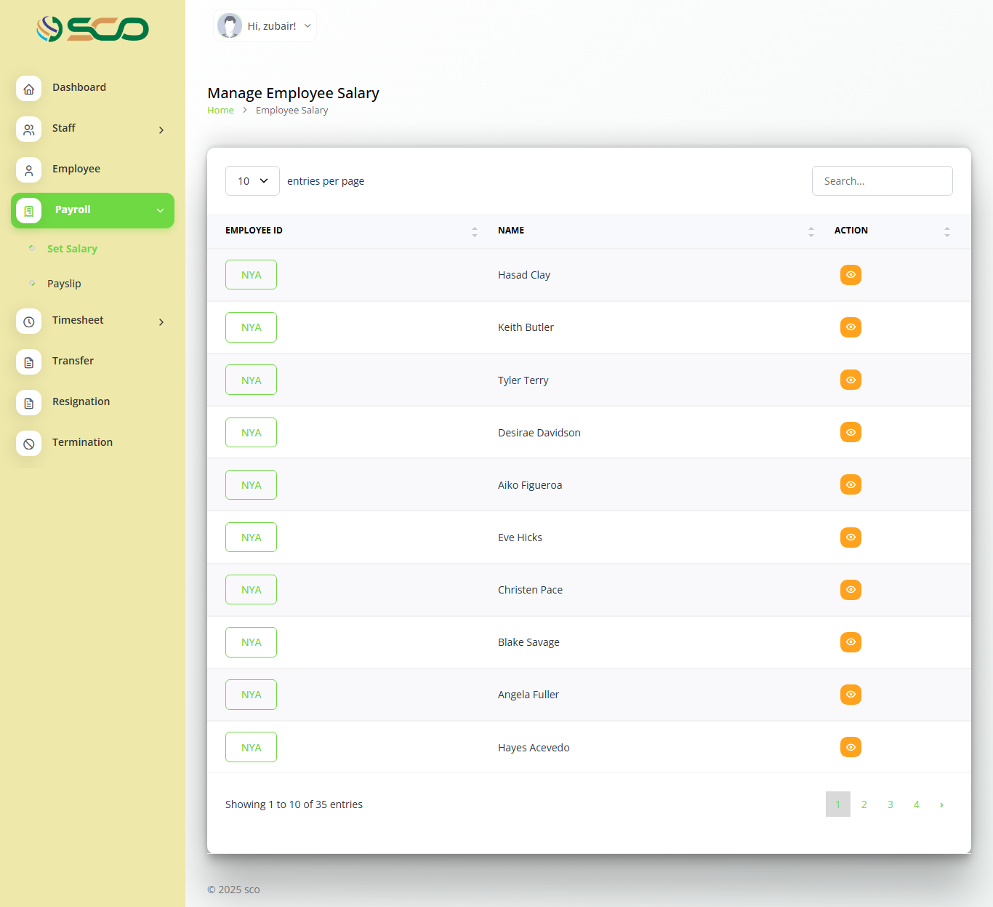
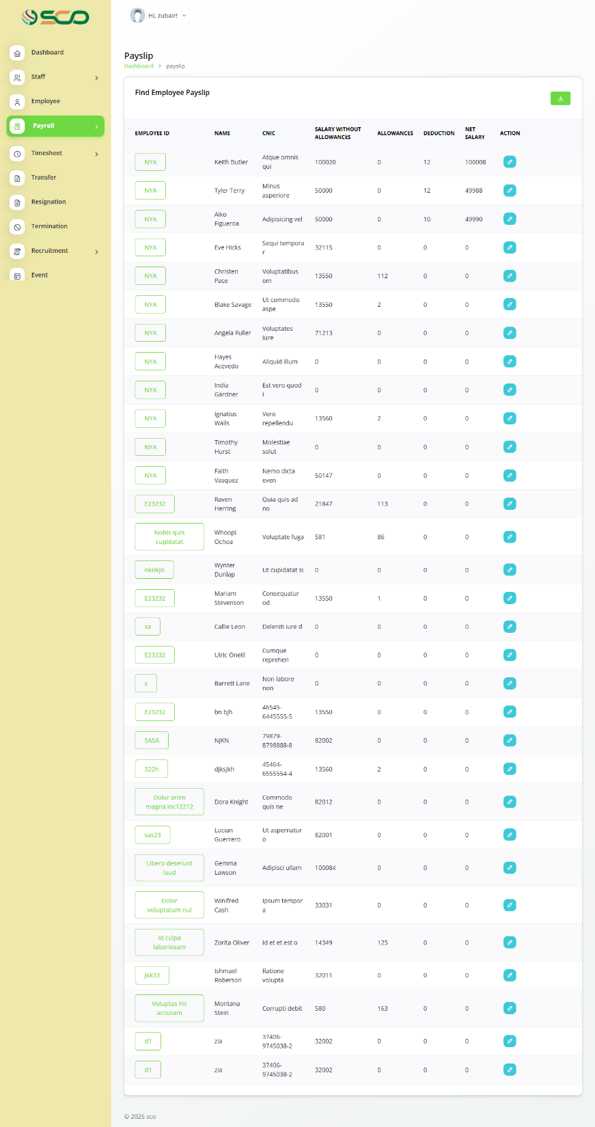
Key Features :: Delivery Status
Payroll Management
Sr#. | Module | Feature | Status | Remarks
20 | Payroll Management | Salary Breakdown | Complete | This module is completed and tested by the developer and awaiting SCO feedback
21 |  | Salary Export Data | Complete | This module is completed and tested by the developer and awaiting SCO feedback
22 |  | Payroll List View | Complete | This module is completed and tested by the developer and awaiting SCO feedback
23 |  | Payroll Deduction | Complete | This module is completed and tested by the developer and awaiting SCO feedback
24 |  | Payroll Export Data | Complete | This module is completed and tested by the developer and awaiting SCO feedback

Slide 7
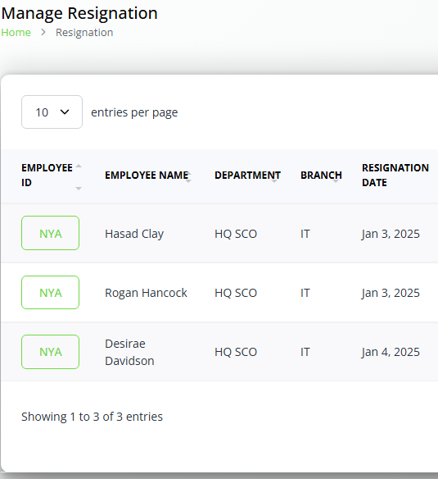
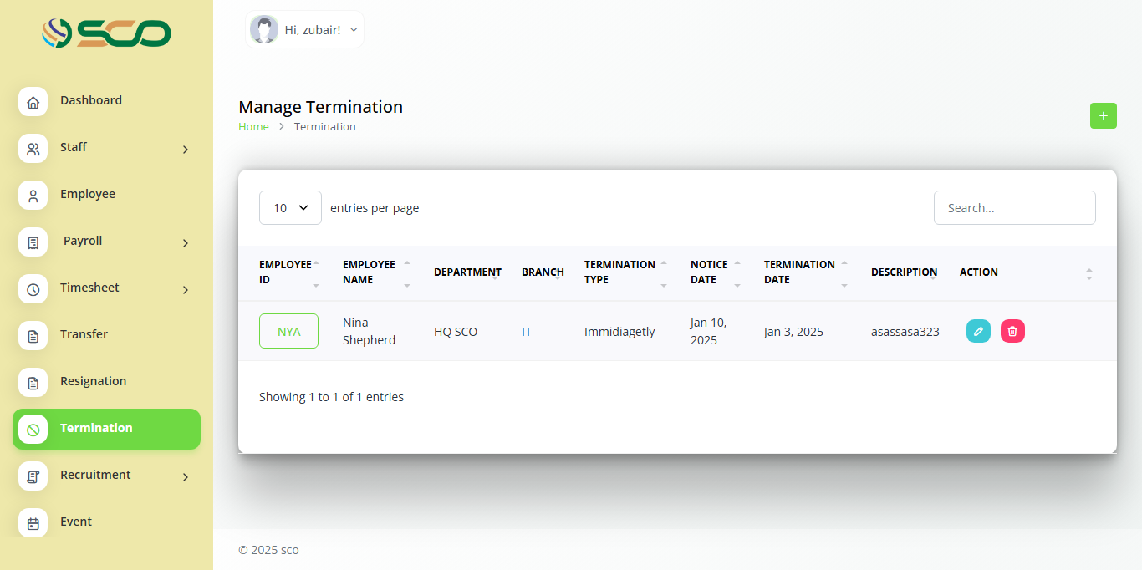
Key Features :: Delivery Status
Transfers, Resignation & Terminations
Sr#. | Module | Feature | Status | Remarks
39 | Transfers Management | Transfer Creation | Complete | This module is completed and tested by the developer and awaiting SCO feedback
40 |  | Transfer List View | Complete | This module is completed and tested by the developer and awaiting SCO feedback
41 | Resignation Management | Resignation Creation | Complete | This module is completed and tested by the developer and awaiting SCO feedback
42 |  | Resignation List View | Complete | This module is completed and tested by the developer and awaiting SCO feedback
43 | Termination Management | Termination Creation | Complete | This module is completed and tested by the developer and awaiting SCO feedback
44 |  | Termination List View | Complete | This module is completed and tested by the developer and awaiting SCO feedback

Slide 8
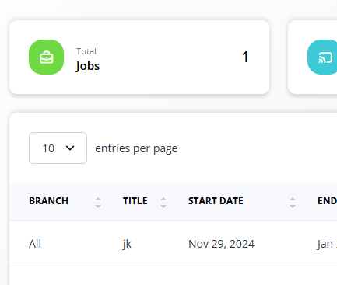

Key Features :: Delivery Status
Recruitment Management
Sr#. | Module | Feature | Status | Remarks
45 | Recruitment Management | Job Creation | Complete | This module is completed and tested by the developer and awaiting SCO feedback
46 |  | Job List View | Complete | This module is completed and tested by the developer and awaiting SCO feedback
47 |  | Career Page Integration and Candidates Applications | Complete | This module is completed and tested by the developer and awaiting SCO feedback
48 |  | Job Applications List View | Complete | This module is completed and tested by the developer and awaiting SCO feedback
49 |  | Job Applications Filters | Complete | This module is completed and tested by the developer and awaiting SCO feedback
50 |  | Interview Schedule Creation | Complete | This module is completed and tested by the developer and awaiting SCO feedback
51 |  | Job Applications Archived List View | Complete | This module is completed and tested by the developer and awaiting SCO feedback
52 |  | Custom Questions List View | Complete | This module is completed and tested by the developer and awaiting SCO feedback
53 |  | Custom Questions Creation | Complete | This module is completed and tested by the developer and awaiting SCO feedback
54 |  | Interview Schedule Calendar List View | Complete | This module is completed and tested by the developer and awaiting SCO feedback
55 |  | Interview Schedule Export Data | Complete | This module is completed and tested by the developer and awaiting SCO feedback

Slide 9
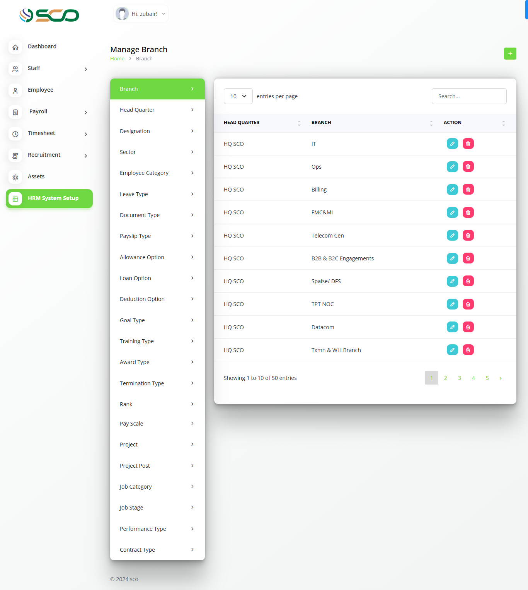
Key Features :: Delivery Status
Configurations & Asset Management
Sr#. | Module | Feature | Status | Remarks
56 | Assets Management | Asset Creation | Complete | This module is completed and tested by the developer and awaiting SCO feedback
57 |  | Export Asset Data | Complete | This module is currently under testing and awaiting feedback.
58 | HRM System Setup | All System Configuration Creation and Deletion | Complete | This module is completed and tested by the developer and awaiting SCO feedback

Slide 10



REACH US
BIRDVIEW LOGIC PRIVATE LIMITED
Corporate Office
5th Floor, Feroz Center, Workzone, G 6/2 Blue Area, Islamabad.
UAN: +92 304 111 9980
info@bvlogic.com www. bvlogic.com
USA Office
Birdview Logic Inc. 3725 Vernon Blvd Long Island City, NY 11746
UK Office
Birdview Logic RMS 277, Essex
28 Fuller Road. Dagenham,
UAE Office
BvLogic LLC
P.O. Box No. 32925, Dubai, United Arab Emirates
Business Hub
Ali Tower, Zubaida's basement, Kohinoor Town , Jaranwala Road, Faisalabad.
Ph: +92 (41) 547 5500

